Slide 1
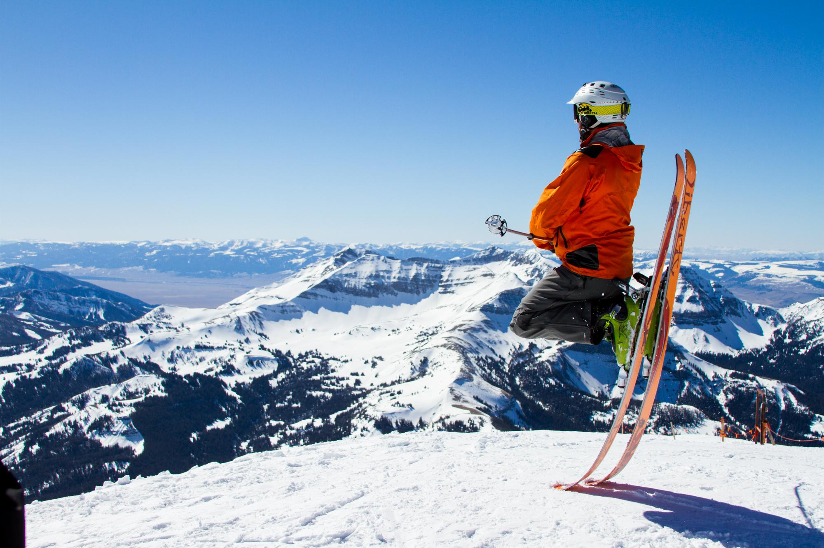
Big Mountain Resort
Guided Capstone Project
by Abel Mekuria

Slide 2
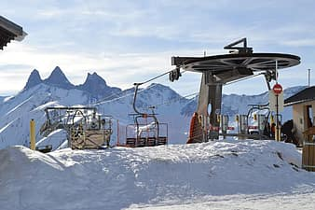
Big Mountain Resort
Big Mountain Resort located in Northern Montana
It has recently installed an additional chair lift to help increase the distribution of visitors across the mountain
This increases their operational cost by $1,540,000

Slide 3

Problem Identification
In order to keep the resort’s profit margin to 9.2 %, the resort needs to identify how much they can benefit from the additional chairs.
The new installed chair will be the company more competitive than its competitors.
Using the data from 330 resorts in the US and the Big Mount resort data, it will be important to investigate how increasing the price of the tickets will make them make more profits.

Slide 4
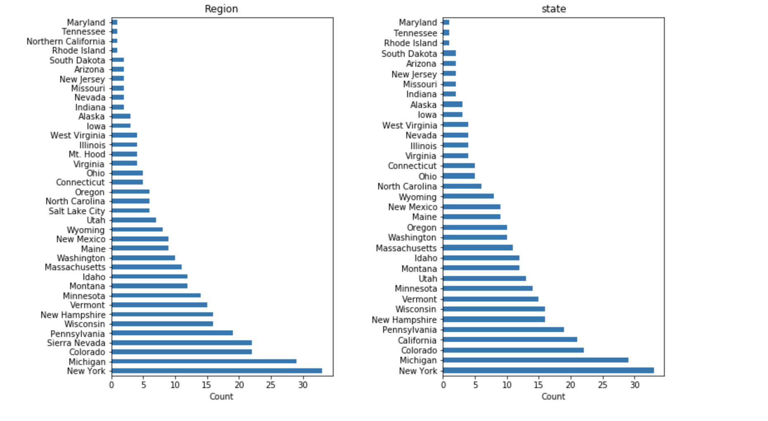
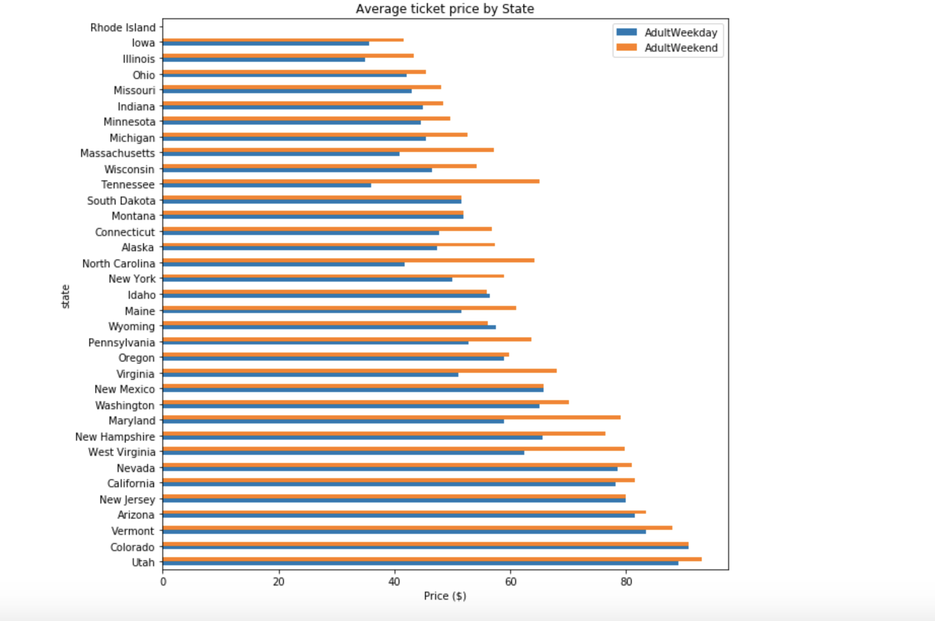
Key findings
Distribution of resorts by state and region
Average ticket price by state

Slide 5
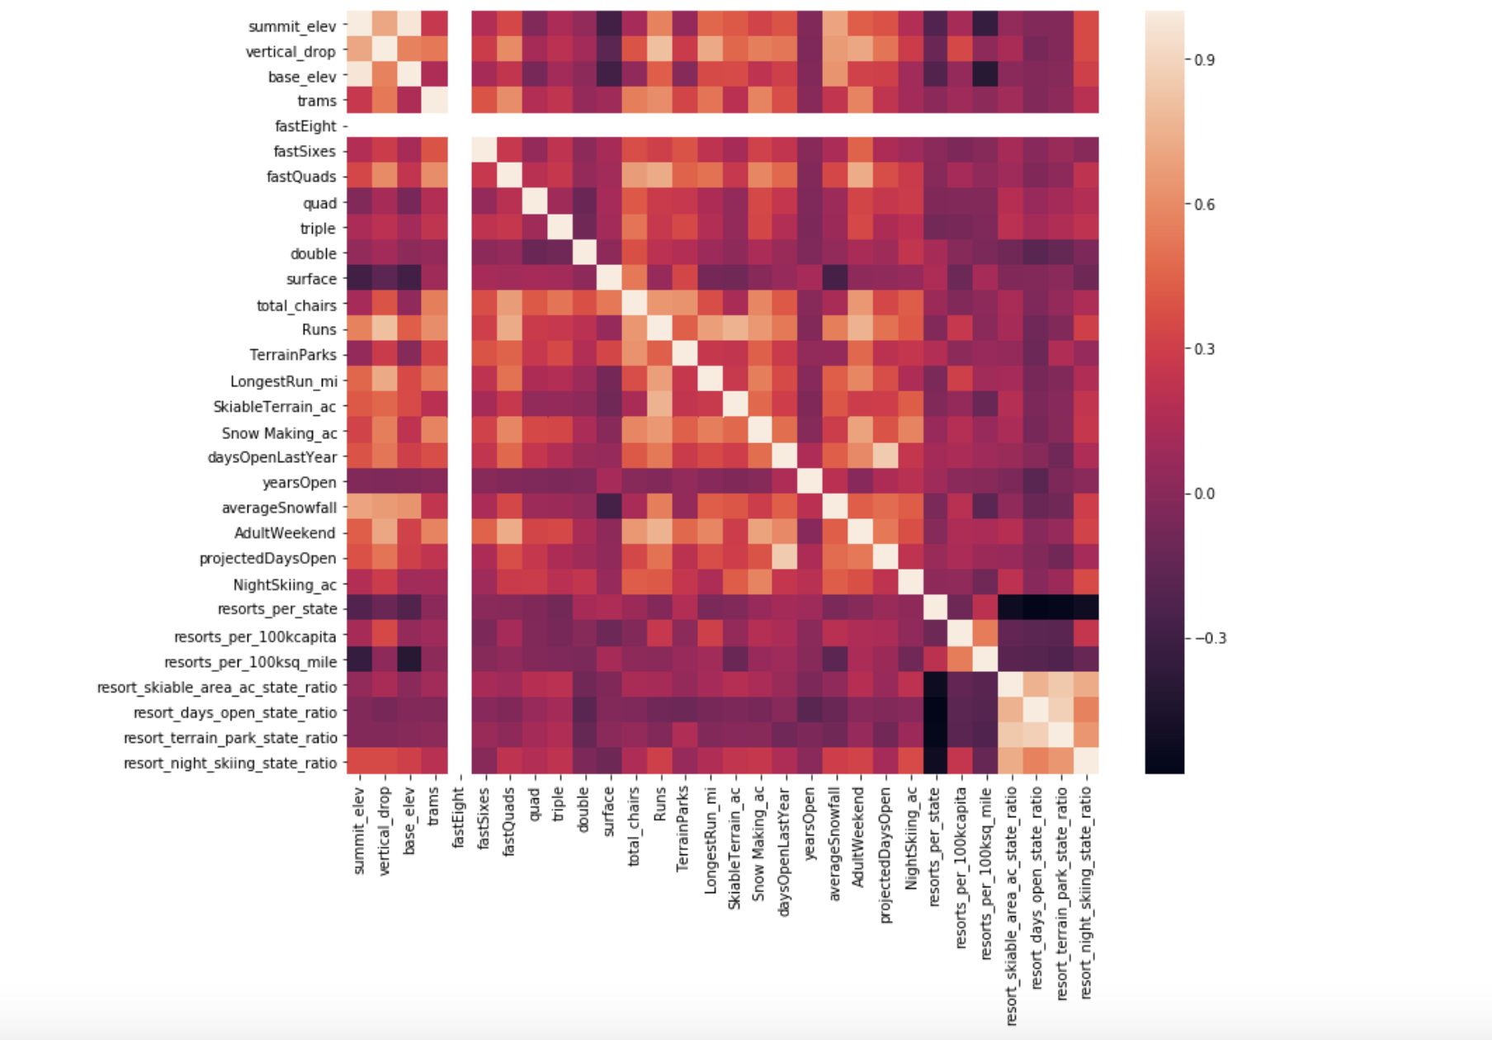
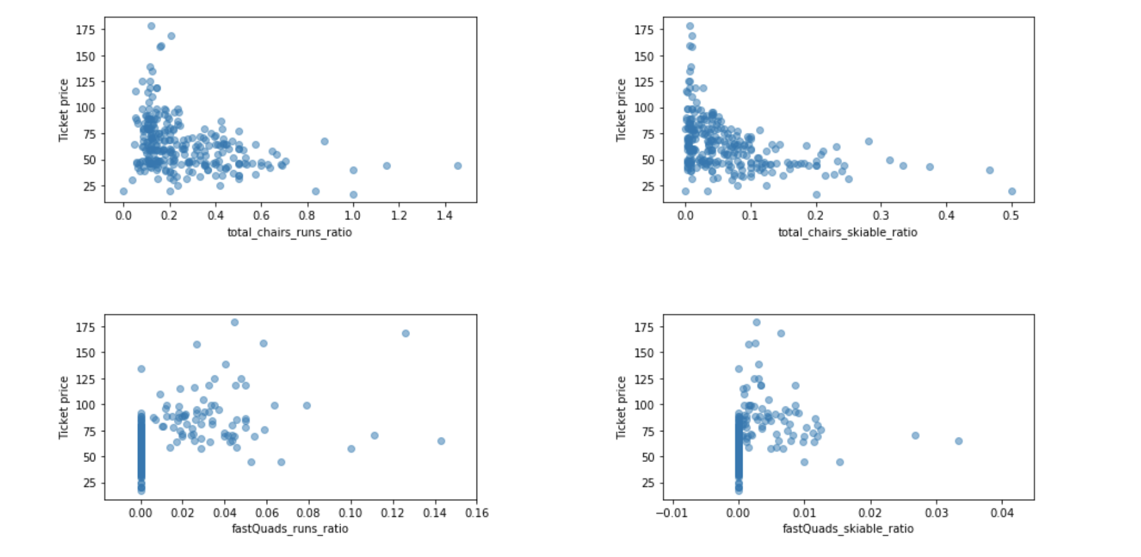
Key findings
Feature correlation heatmap
Scatterplots of numeric features against ticket price

Slide 6
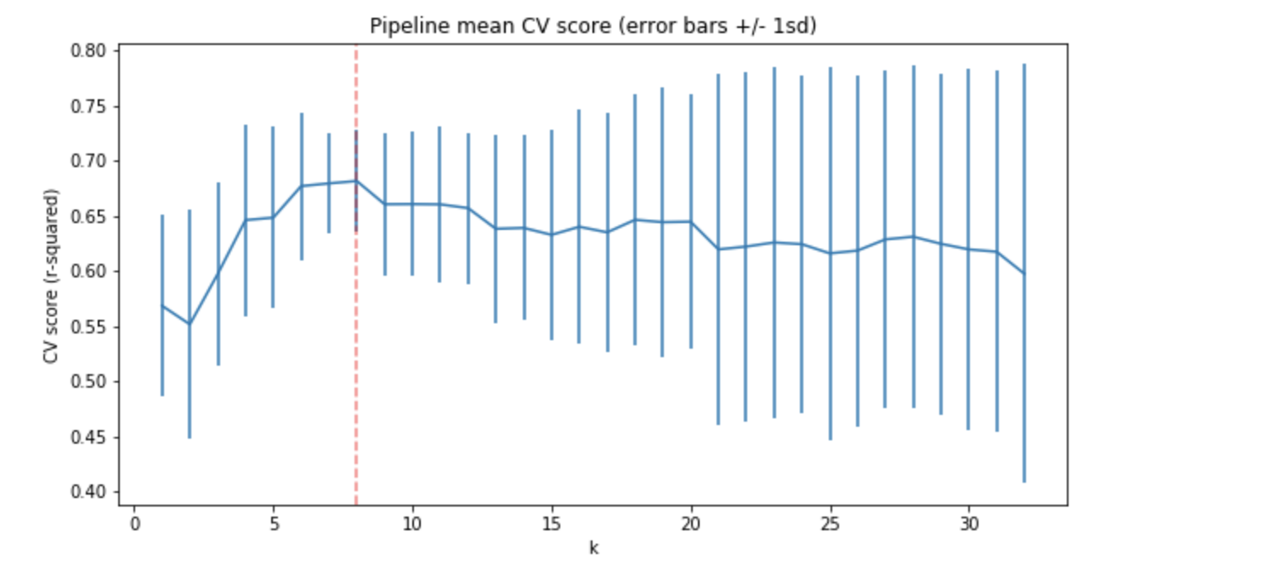
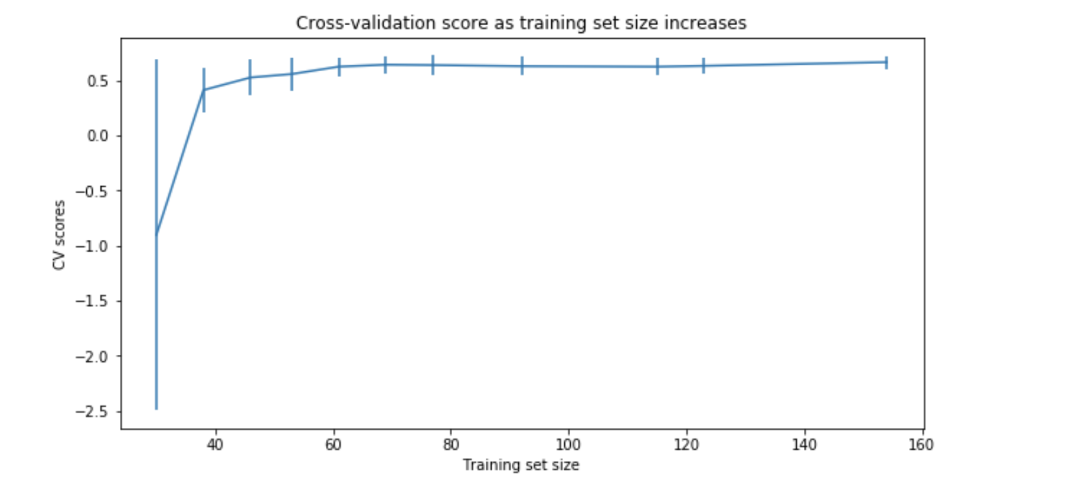
Modeling Results and Analysis
Random forest regression model
Cross-validation score test

Slide 7
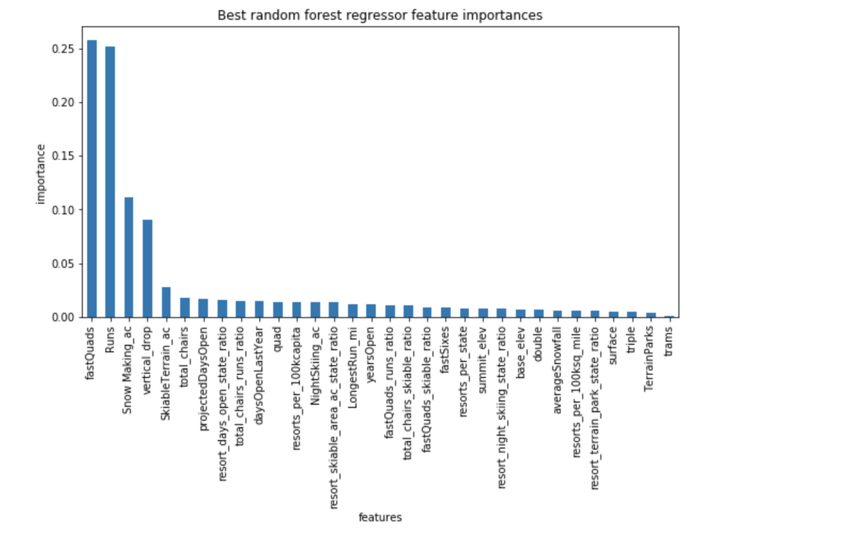
Random Forest Regression Model

Slide 8
Summary and Conclusion
The forest regressor suggests a ticket price of $94.22
Four modeling scenarios
Closing the least used runs
Increasing the vertical drop by adding a run to a point 150 feet lower down
Increasing the longest run by .2 miles
Increasing 2 acres of snow making
Scenario 1 and 2 increases support for ticket price by $ 2 and $3,474,638 (over the season)

Slide 9
Acknowledgement
Special thanks to my mentor Kevin Chang and springboard team

